Slide 1
WELCOME TO MY PRESENTATION
MST.RUHANA FAIRUZ
ID:1910022

Slide 2
Topic: Prescription Pattern and Awareness among Diabetic Patients in Rangpur Division

Slide 3
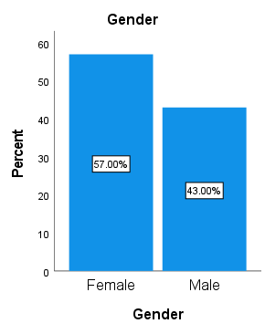
RESULTS ABOUT MY TOPIC:
Diabetes distribution profile on gender:
Table 1: Diabetes distribution profile on gender:
Gender
 |  | Frequency | Percent | Valid Percent | Cumulative Percent
Valid | Female | 114 | 57.0 | 57.0 | 57.0
 | Male | 86 | 43.0 | 43.0 | 100.0
 | Total | 200 | 100.0 | 100.0

Slide 4
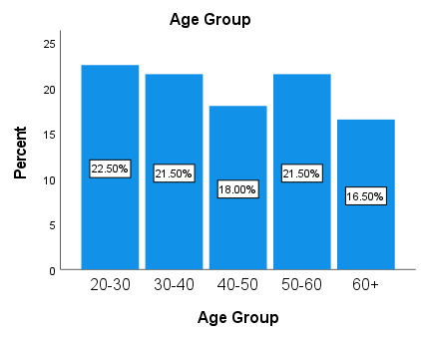
Diabetic patients’ distribution profile on age:
Table 2: Diabetic patients’ distribution profile on age:
Age Group
 |  | Frequency | Percent | Valid Percent | Cumulative Percent
Valid | 20-30 | 45 | 22.5 | 22.5 | 22.5
 | 30-40 | 43 | 21.5 | 21.5 | 44.0
 | 40-50 | 36 | 18.0 | 18.0 | 62.0
 | 50-60 | 43 | 21.5 | 21.5 | 83.5
 | 60+ | 33 | 16.5 | 16.5 | 00.0
 | Total | 200 | 100.0 | 100.0

Slide 5
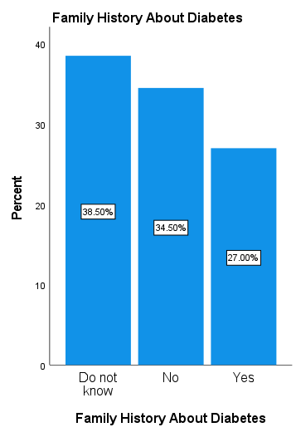
Diabetic patients’ distribution profile on family history:
Table 3: Diabetic patients’ distribution profile on family history:
Family History About Diabetes
 |  | Frequency | Percent | Valid Percent | Cumulative Percent
Valid | Do not Know | 77 | 38.5 | 38.5 | 38.5
 | No | 69 | 34.5 | 34.5 | 73.0
 | Yes | 54 | 27.0 | 27.0 | 100.0
 | Total | 200 | 100.0 | 100.0

Slide 6
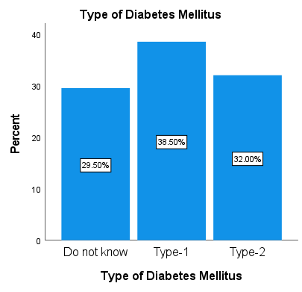
Distribution of diabetic patients based on types of diabetes:
Table 4: Distribution of diabetic patients based on types of diabetes:
Type of Diabetes Mellitus
 |  | Frequency | Percent | Valid Percent | Cumulative Percent
Valid | Do not know | 59 | 29.5 | 29.5 | 29.5
 | Type-1 | 77 | 38.5 | 38.5 | 68.0
 | Type-2 | 64 | 32.0 | 32.0 | 100.0
 | Total | 200 | 100.0 | 100.0

Slide 7
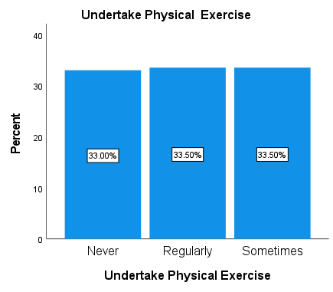
Distribution based on exercise status:
Table 5: Distribution based on exercise status:
Undertake Physical Exercise
 |  | Frequency | Percent | Valid Percent | Cumulative Percent
Valid | Never | 66 | 33.0 | 33.0 | 33.0
 | Regularly | 67 | 33.5 | 33.5 | 66.5
 | Sometimes | 67 | 33.5 | 33.5 | 100.0
 | Total | 200 | 100.0 | 100.0

Slide 8
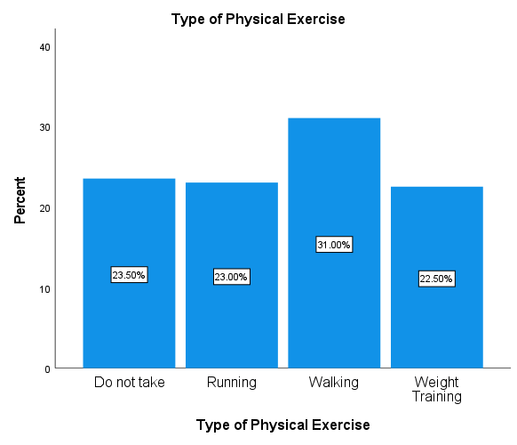
Distribution based on Types of Physical exercise:
Table 6: Distribution based on Types of Physical exercise:
Type of Physical Exercise
 |  | Frequency | Percent | Valid Percent | Cumulative Percent
Valid | Do not Take | 47 | 23.5 | 23.5 | 23.5
 | Running | 46 | 23.0 | 23.0 | 46.5
 | Walking | 62 | 31.0 | 31.0 | 77.5
 | Weight Training | 45 | 22.5 | 22.5 | 100.0
 | Total | 200 | 100.0 | 100.0

Slide 9
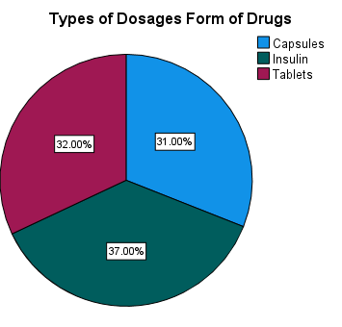
Distribution based on dosage of drugs:
Table 7: Distribution based on dosage of drugs:
Types of Dosages Form of Drugs
 |  | Frequency | Percent | Valid Percent | Cumulative Percent
Valid | Capsules | 62 | 31.0 | 31.0 | 31.0
 | Insulin | 74 | 37.0 | 37.0 | 68.0
 | Tablets | 64 | 32.0 | 32.0 | 100.0
 | Total | 200 | 100.0 | 100.0

Slide 10
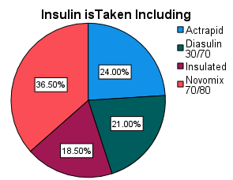
Distribution based on Insulin is Taken:
Table 8: Distribution based on Insulin is Taken
Insulin is Taken Including
 |  | Frequency | Percent | Valid Percent | Cumulative Percent
Valid | Actrapid | 48 | 24.0 | 24.0 | 24.0
 | Diasulin 30/70 | 42 | 21.0 | 21.0 | 45.0
 | Insulated | 37 | 18.5 | 18.5 | 63.5
 | Novomix 70/80 | 73 | 36.5 | 36.5 | 100.0
 | Total | 200 | 100.0 | 100.0

Slide 11
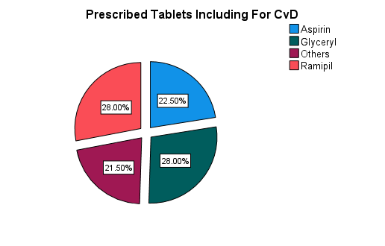
Distribution based on Prescribed Tablets Including For CvD
Table 9: Distribution based Prescribed Tablets Including For CvD
Prescribed Tablets Including For CvD
 |  | Frequency | Percent | Valid Percent | Cumulative Percent
Valid | Aspirin | 45 | 22.5 | 22.5 | 22.5
 | Glyceryl | 56 | 28.0 | 28.0 | 50.5
 | Others | 43 | 21.5 | 21.5 | 72.0
 | Ramipil | 56 | 28.0 | 28.0 | 100.0
 | Total | 200 | 100.0 | 100.0

Slide 12
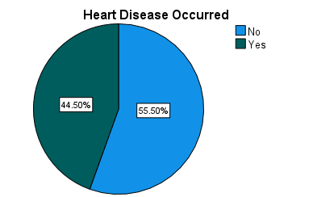
Distribution based on Heart Disease
Table 11: Distribution based on Heart Disease
Heart Disease Occurred
 |  | Frequency | Percent | Valid Percent | Cumulative Percent
Valid | No | 111 | 55.5 | 55.5 | 55.5
 | Yes | 89 | 44.5 | 44.5 | 100.0
 | Total | 200 | 100.0 | 100.0

Slide 13
Analysis of Crosstabulation:
Age Group VS Type of Diabetes Mellitus
Chi-Square Tests
 | Value | df | Asymptotic Significance (2-sided)
Pearson Chi-Square | 2.230ª | 8 | .973
Likelihood Ratio | 2.273 | 8 | .971
N of Valid Cases | 200
a. 0 cells (0.0%) have expected count less than 5. The minimum expected count is 9.74.
 |  | Type of Diabetes Mellitus |  |  | Total
 |  | Do not Know | Type-1 | Type-2
Age Group | 20-30 | 15 | 17 | 13 | 45
 | 30-40 | 11 | 17 | 15 | 43
 | 40-50 | 8 | 16 | 12 | 36
 | 50-60 | 14 | 15 | 14 | 43
 | 60+ | 11 | 12 | 10 | 33
Total |  | 59 | 77 | 64 | 200
Prescribed Tablets Including VS Types of Dosages Form of Drugs
 |  | Types of Dosages Form of Drugs |  |  | Total
 |  | Capsules | Insulin | Tablets
Prescribed Tablets Including | Aldorin | 0 | 2 | 0 | 2
 | Angkor 5 | 1 | 0 | 0 | 1
 | Hypen SR | 2 | 2 | 0 | 4
 | Linatab 2.5/500 | 0 | 0 | 1 | 1
 | Aldorin | 18 | 12 | 14 | 44
 | Angkor 2.5 | 10 | 18 | 16 | 44
 | Angkor 5 | 11 | 12 | 8 | 31
 | Hypen SR | 8 | 14 | 10 | 32
 | Linatab 2.5/500 | 10 | 11 | 11 | 32
 | Osartil 50 | 2 | 3 | 4 | 9
Total |  | 62 | 74 | 64 | 200
Chi-Square Tests
 | Value | df | Asymptotic Significance (2-sided)
Pearson Chi-Square | 15.796ª | 18 | .607
Likelihood Ratio | 17.895 | 18 | .463
N of Valid Cases | 200
a. 15 cells (50.0%) have expected count less than 5. The minimum expected count is .31.

